Slide 1
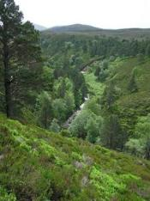
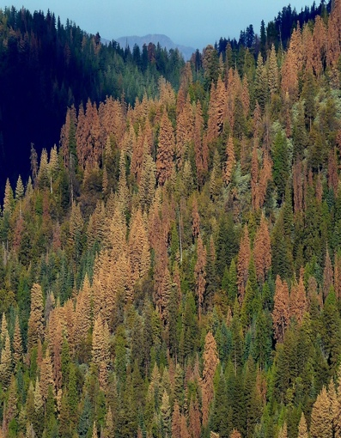
4. Introduction to BDT
USGS CC PDM 1.0
Workshop IBS-Germany & DVFFA, Lübeck, 2025-09-24-26

Slide 2
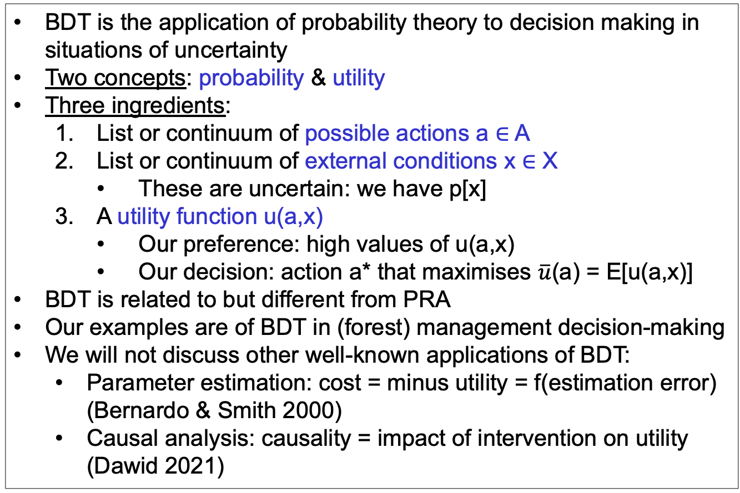
Bayesian Decision Theory (BDT)
BDT is the application of probability theory to decision making in situations of uncertainty
Two concepts: probability & utility
Three ingredients:
List or continuum of possible actions a ∈ A
List or continuum of external conditions x ∈ X
These are uncertain: we have p[x]
A utility function u(a,x)
Our preference: high values of u(a,x)
Our decision: action a* that maximises $\overline{u}$(a) = E[u(a,x)]
BDT is related to but different from PRA
Our examples are of BDT in (forest) management decision-making
We will not discuss other well-known applications of BDT:
Parameter estimation: cost = minus utility = f(estimation error) (Bernardo & Smith 2000)
Causal analysis: causality = impact of intervention on utility (Dawid 2021)

Slide 3
Graphical models: From PRA to BDT
PRA
BDT
u
z
z
x
a
x
p[x,z] =
p[x] p[z|x]
p[x,z,u|a] =
p[x] p[z|a,x] p[u|a,z]

Slide 4
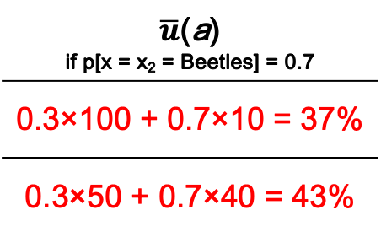
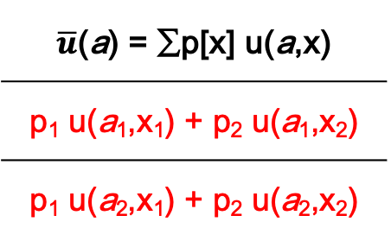
Utility matrix for discrete u(a,x)
 | x = x₁ | x = x₂
a = a₁ | u(a₁,x₁) | u(a₁,x₂)
a = a₂ | u(a₂,x₁) | u(a₂,x₂)
$\overline{u}$(a) = ∑p[x] u(a,x)
p₁ u(a₁,x₁) + p₂ u(a₁,x₂)
p₁ u(a₂,x₁) + p₂ u(a₂,x₂)
u
z
% Tree survival | No beetles | Beetles
No thin | 100% | 10%
50% thin | 50% | 40%
$\overline{u}$(a) if p[x = x₂ = Beetles] = 0.7
0.3×100 + 0.7×10 = 37%
0.3×50 + 0.7×40 = 43%
a
x
We want to maximise expected utility $\overline{u}$(a), so we choose a₂

Slide 5
Value of Information: Impact on expected utility
Only prior information p[x]:
Specific information y:
Information yet to be received Y = {y}:
‘Perfect’ information so you can always (for every x) choose the best action:

Slide 6
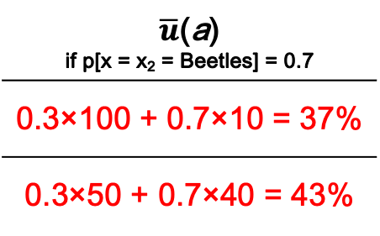
Value of Information in the tree beetle example
If y = {y₁,y₂} and
p[y₁|x₁] = p[y₂|x₂] = 0.6
u
VoI_{partial} = 43.6 – 43 = 0.6%
VoI_{perfect} = 58 – 43 = 15%
z
% Tree survival | No beetles | Beetles
No thin | 100% | 10%
50% thin | 50% | 40%
$\overline{u}$(a) if p[x = x₂ = Beetles] = 0.7
0.3×100 + 0.7×10 = 37%
0.3×50 + 0.7×40 = 43%
a
x

Slide 7
Value of Bad Information in the tree beetle example
What would happen to VoI_{partial} if p[y₁|x₁] = p[y₂|x₂] = 0.5?

Slide 8
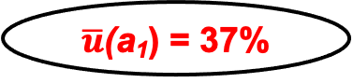
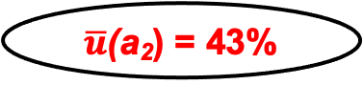
Decision tree
u₁₁ = 100%
No beetles
p=0.3
x
$\overline{u}$(a₁) = 37%
No thin
Beetles
p=0.7
u₁₂ = 10%
a
Thin
No beetles
p=0.3
u₂₁ =50%
x
$\overline{u}$(a₂) = 43%
Beetles
p=0.7
u₂₂ =40%

Slide 9
Sequential decisions
No beetles
p=0.3
x
No thin
Beetles
p=0.7
a
Thin
No beetles
p=0.3
x
Beetles
p=0.7

Slide 10
Graphical models: From PRA to BDT
PRA
BDT
u
u
u
cost
benefit
cost
benefit
z
z
z
z
𝜺
x
a
x
a
x
a
x
𝝑
p[x,z] =
p[x] p[z|x]
p[x,z,u|a] =
p[x] p[z|a,x] p[u|a,z]
z = f(a,x,𝝑) + 𝜺
p[x], p[𝝑], p[𝜺]

Slide 11
BDT for forestry
Utility
u
Management costs
cost
benefit
Timber sale
Forest growth
z
𝜺
Model error
Management actions
a
x
𝝑
Model parameters
Climate

Slide 12
Ignoring uncertainties and errors for a moment ...
100.00
--------
Model
YC = £ 180.00 ha⁻¹ y⁻¹
WUE
Irrigation
u
YC
Rain
200.00
-----
300.00
--------
z = 0.01 (x + a)
u = 30 z - 0.5 a
£ 0.00
ha⁻¹ y⁻¹
cost
benefit
£ 180.00 ha⁻¹ y⁻¹
Timber
price
Irrigation costs
10
---
YC = 6
m³ ha⁻¹ y⁻¹
z
𝜺
a
x
𝝑
400
--
Irrigation = 0 mm y⁻¹
Rain = 600 mm y⁻¹
WUE = 0.01
m³ ha⁻¹ mm⁻¹

Slide 13
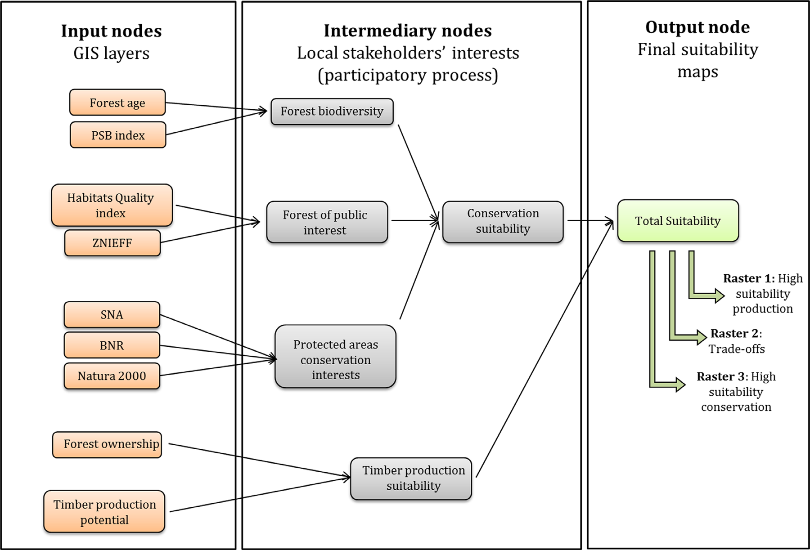
Gonzales-Redin et al. (2016)
Gonzalez Redin, J. et al. (2016). Spatial Bayesian belief networks as a planning decision tool for mapping ecosystem services trade-offs on forested landscapes. Environmental Research 144: 15-26.

Slide 14
Now with all uncertainties!
u
E[u|a] = ∫ E[u(a,x)] p[x] dx
cost
benefit
E[u(a,x)] = ∫ ∫ p[z|x,θ,a] p[θ|y] dθ p[x] dx
z
𝜺
p[ε]
p[θ|y]
p[x]
a
x
𝝑
z = f(a,x,𝝑) + 𝜺
p[x], p[𝝑], p[𝜺]
p[ε_{y}]
p[θ]

Slide 15
5. Links between PRA and BDT
USGS CC PDM 1.0
Workshop IBS-Germany & DVFFA, Lübeck, 2025-09-24-26

Slide 16
6. General discussion
USGS CC PDM 1.0
Workshop IBS-Germany & DVFFA, Lübeck, 2025-09-24-26

Slide 17
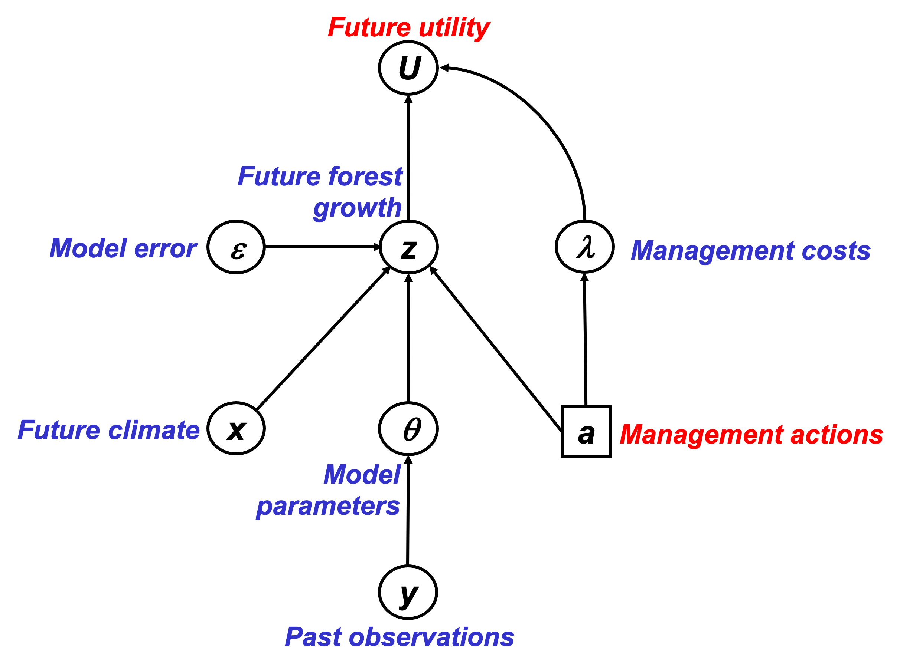
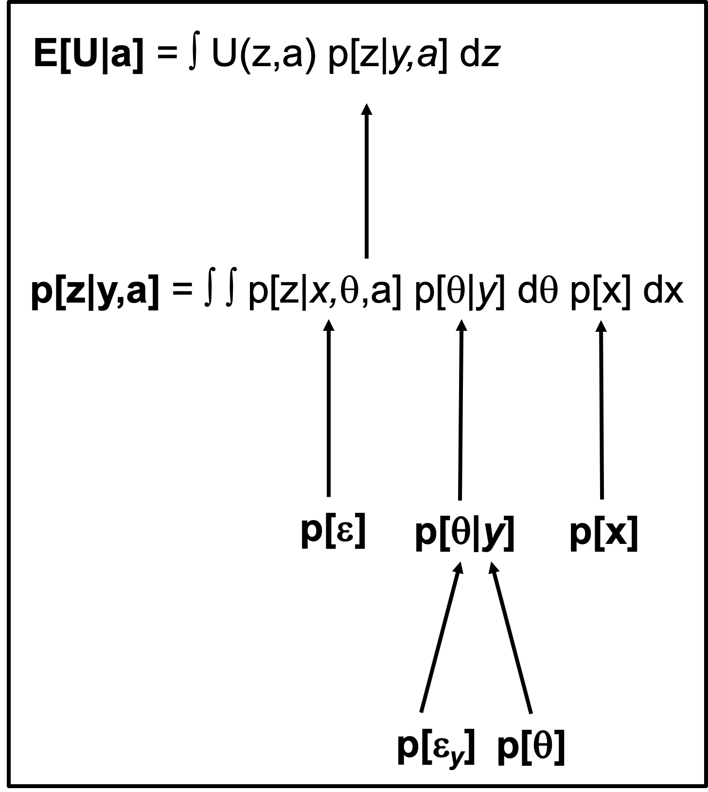
Theory development: PRA & BDT
Probabilistic Risk Analysis (PRA)
Risk = Expected loss = probability(Hazard) * Vulnerability
p(Drought)
Risk
Vulnerability
Van Oijen et al. (2013, 2014, 2019)
Bayesian Decision Theory
(BDT)

Slide 18

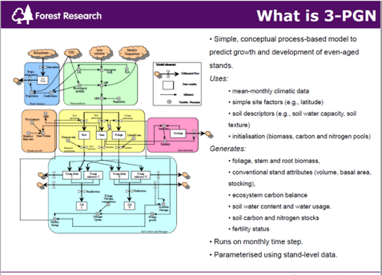
Data & Process-Based Modelling (PBM)
Data
Performance of conifer spp. in UK, Spain, Finland
Environmental conditions (soil, past & future climate)
Forest management
Model drivers
Model test data
Model calibration data
PBM
BASFOR, 3PGN, …
Quantifying past & future forest performance
Analysing forest vulnerability to drought
Analysing impacts of management

Slide 19
Project flowchart & Decision Support System (DSS)
Data
PRA
DSS
PBM
BDT

Slide 20
Deeper analysis of p[H] and V
Analysing p[H]. Compare with FTA in systems with binary outcomes. Use BBN. Or PBM.

Slide 21
Lecina-Diaz et al. (2020)

Slide 22
Lecina-Diaz et al. (2020)

Slide 23
PRAFOR (2020-2022) - Why?
Need to know where/what to plant to ensure 'climate-smart' forestry (carbon sequestration)
To underpin land-use decision making needs information on risks in a way that supports decisions making to mitigate drought (and other) risks.

Slide 24
PRAFOR objectives
1. Show under which conditions p[H], E and V can be treated as independent variables.
2. Show under which conditions uncertainties in p[H], E and V can be quantified analytically.
3. Derive numerical approximation algorithms for non-analytical conditions.
4. Show how the PRA is a special case of Bayesian Decision Theory and compare strengths and weaknesses of PRA vs. full BDT.
5. Use observational data to analyse risks from global change to forests in the UK, Spain and Finland.
6. Use outputs from forest simulation modelling to predict and analyse future risks.
7. Analyse the simulation model to identify the key system properties that determine vulnerability.
8. Produce an interactive app for probabilistic risk analysis including uncertainty quantification.
Theory
Application
Analysis
Process sensitivities, Lag-effects, Adaptation, ...
Communication

Slide 25
Outlook
Theory has been tested on virtual data sets, confirming the accuracy of formulas for uncertainty quantification
Next steps:
Application to real forest data
PRA theory to be embedded in Bayesian decision-theory (BDT) framework
PRA or BDT to be embedded in ESC, the existing Decision Support System of Forest Research U.K.

Slide 26
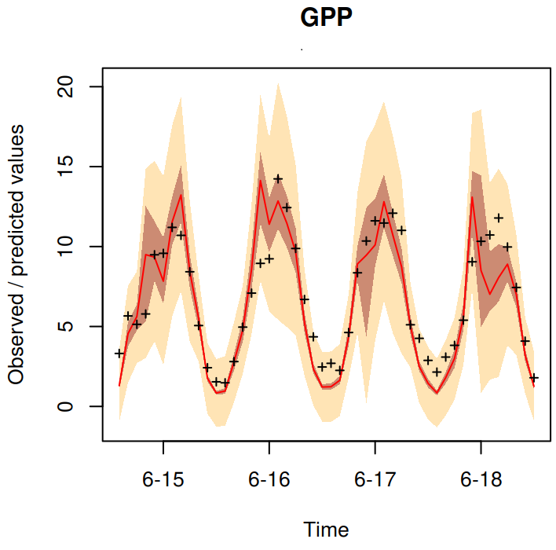
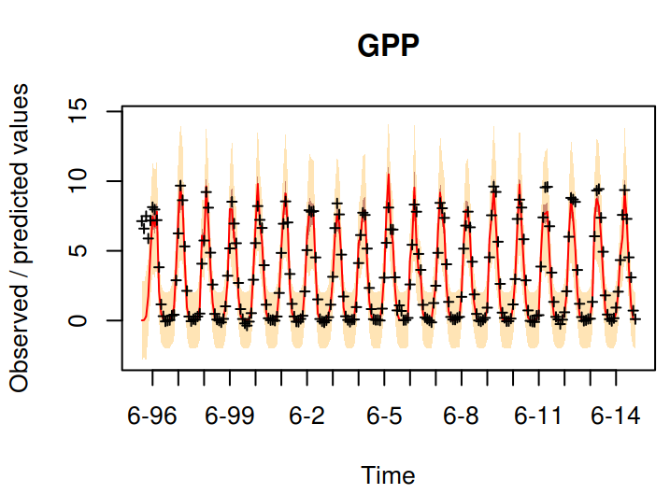
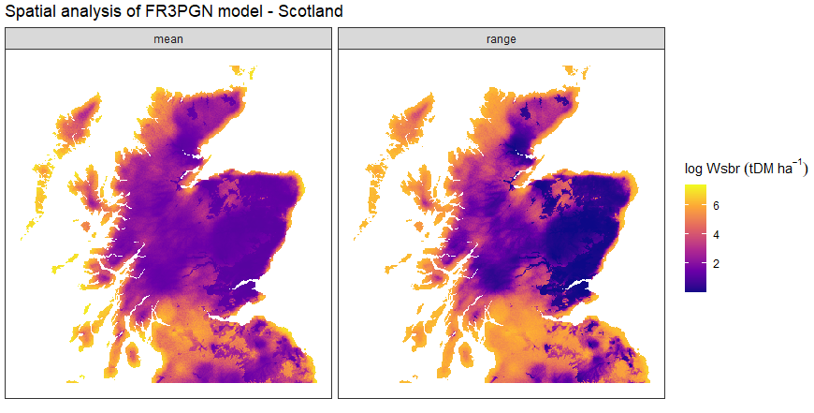
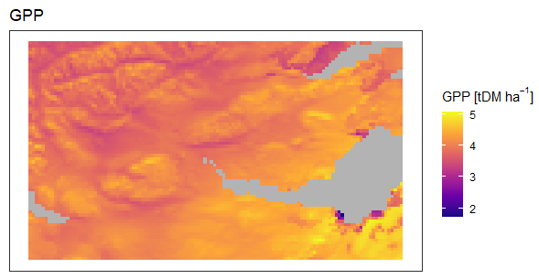
Process-model based drought vulnerability
Two process-based models (BASFOR, 3PGN)
Identify key factors drive present and future forest drought vulnerability.
Bayesian Calibration to reduce uncertainty in model parameters
Forest data (UK, Spain and Finland)
Quantify uncertainty in model error.

Slide 27
ESC: a DSS for tree suitability estimation
• National scale guidance published in 2001.
• Complemented by a computer based decision support system, field survey pack and training course.
• ArcView extension.
• Now embedded in many aspects of GB Forestry.

Slide 28
PRAFOR objectives
1. Show under which conditions p[H], E and V can be treated as independent variables.
2. Show under which conditions uncertainties in p[H], E and V can be quantified analytically.
3. Derive numerical approximation algorithms for non-analytical conditions.
4. Show how the PRA is a special case of Bayesian Decision Theory and compare strengths and weaknesses of PRA vs. full BDT.
5. Use observational data to analyse risks from global change to forests in the UK, Spain and Finland.
6. Use outputs from forest simulation modelling to predict and analyse future risks.
7. Analyse the simulation model to identify the key system properties that determine vulnerability.
8. Produce an interactive app for probabilistic risk analysis including uncertainty quantification.
Theory
Application
Analysis
Process sensitivities, Lag-effects, Adaptation, ...
Communication

Slide 29
Appendices
USGS CC PDM 1.0
Workshop IBS-Germany & DVFFA, Lübeck, 2025-09-24-26

Slide 30
Condition for V being threshold-independent

Slide 31
Six datasets where E[z|x] = a + b F_{x}[x]
x
p[x]
z
a
b F_{x}[x]
𝜺
x_U <- runif(n) ; z_U <- 0.5 + x_U/2 + rnorm(n,0,0.05)
x_E <- rexp(n) ; z_E <- 1 - exp(-x_E)/2 + rnorm(n,0,0.05)
x_B <- rbeta(n,5,1) ; z_B <- 0.5 + pbeta(x_B,5,1)/2 + rnorm(n,0,0.05)
x_t <- rt(n,1,30) ; z_t <- 0.5 + pt(x_t,1,30)/2 + rnorm(n,0,0.05)
x_G <- rnorm(n) ; z_G <- 0.5 + pnorm(x_G)/2 + rnorm(n,0,0.05)
x_L <- rnorm(n) ; z_L <- 0.5 + 0.5/(1+exp(-2*x_L)) + rnorm(n,0,0.05)
We now will do single-threshold PRA on each of these six datasets.
We vary the location of the threshold: 5% quantile of x, 10%, …, 95%.
(So p[H] will vary accordingly.)

Slide 32
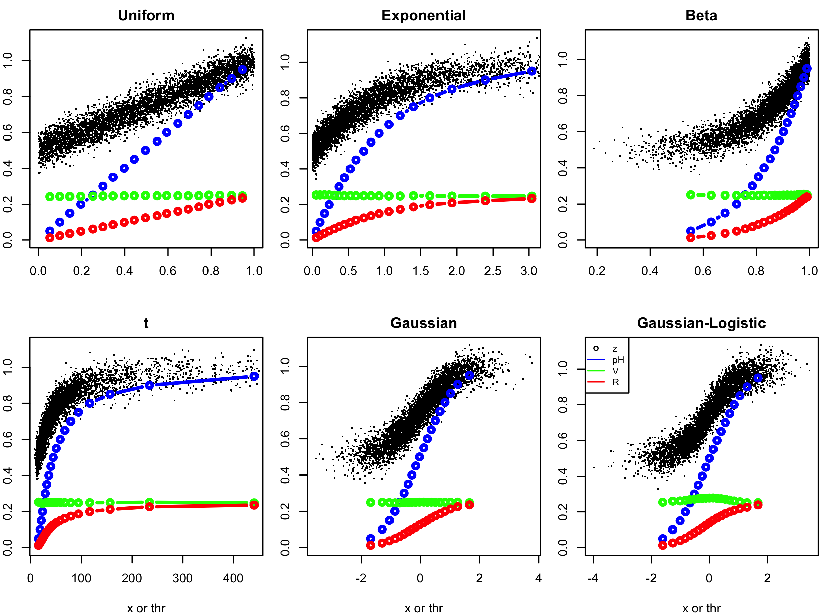
Single-threshold PRA on the six datasets

Slide 33
EXERCISE
What kind of figures do you expect to see if we carry out multi-threshold PRA on these six datasets, using the same 19 threshold levels to define our x-intervals?
Would V be constant, i.e. independent of the x-interval?
How would p[H] vary between the intervals?

Slide 34
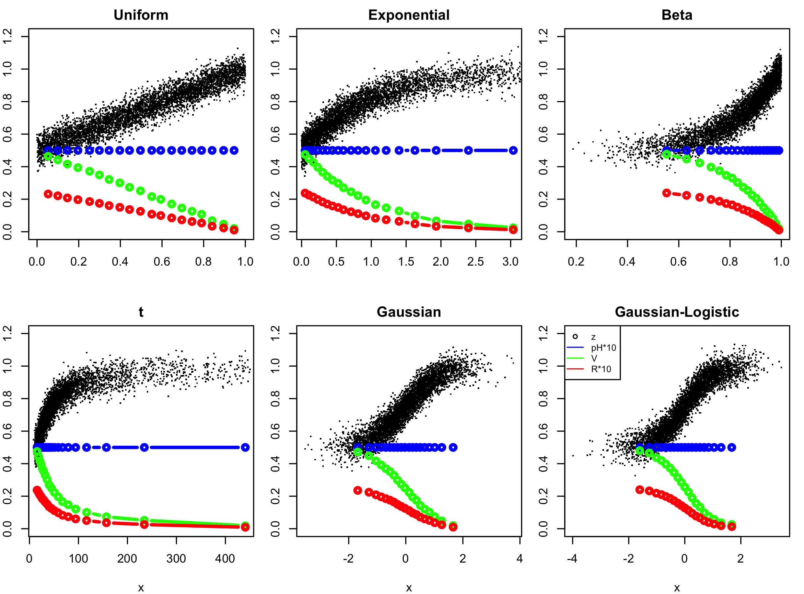
Multi-threshold PRA with equal-p[H] intervals

Slide 35
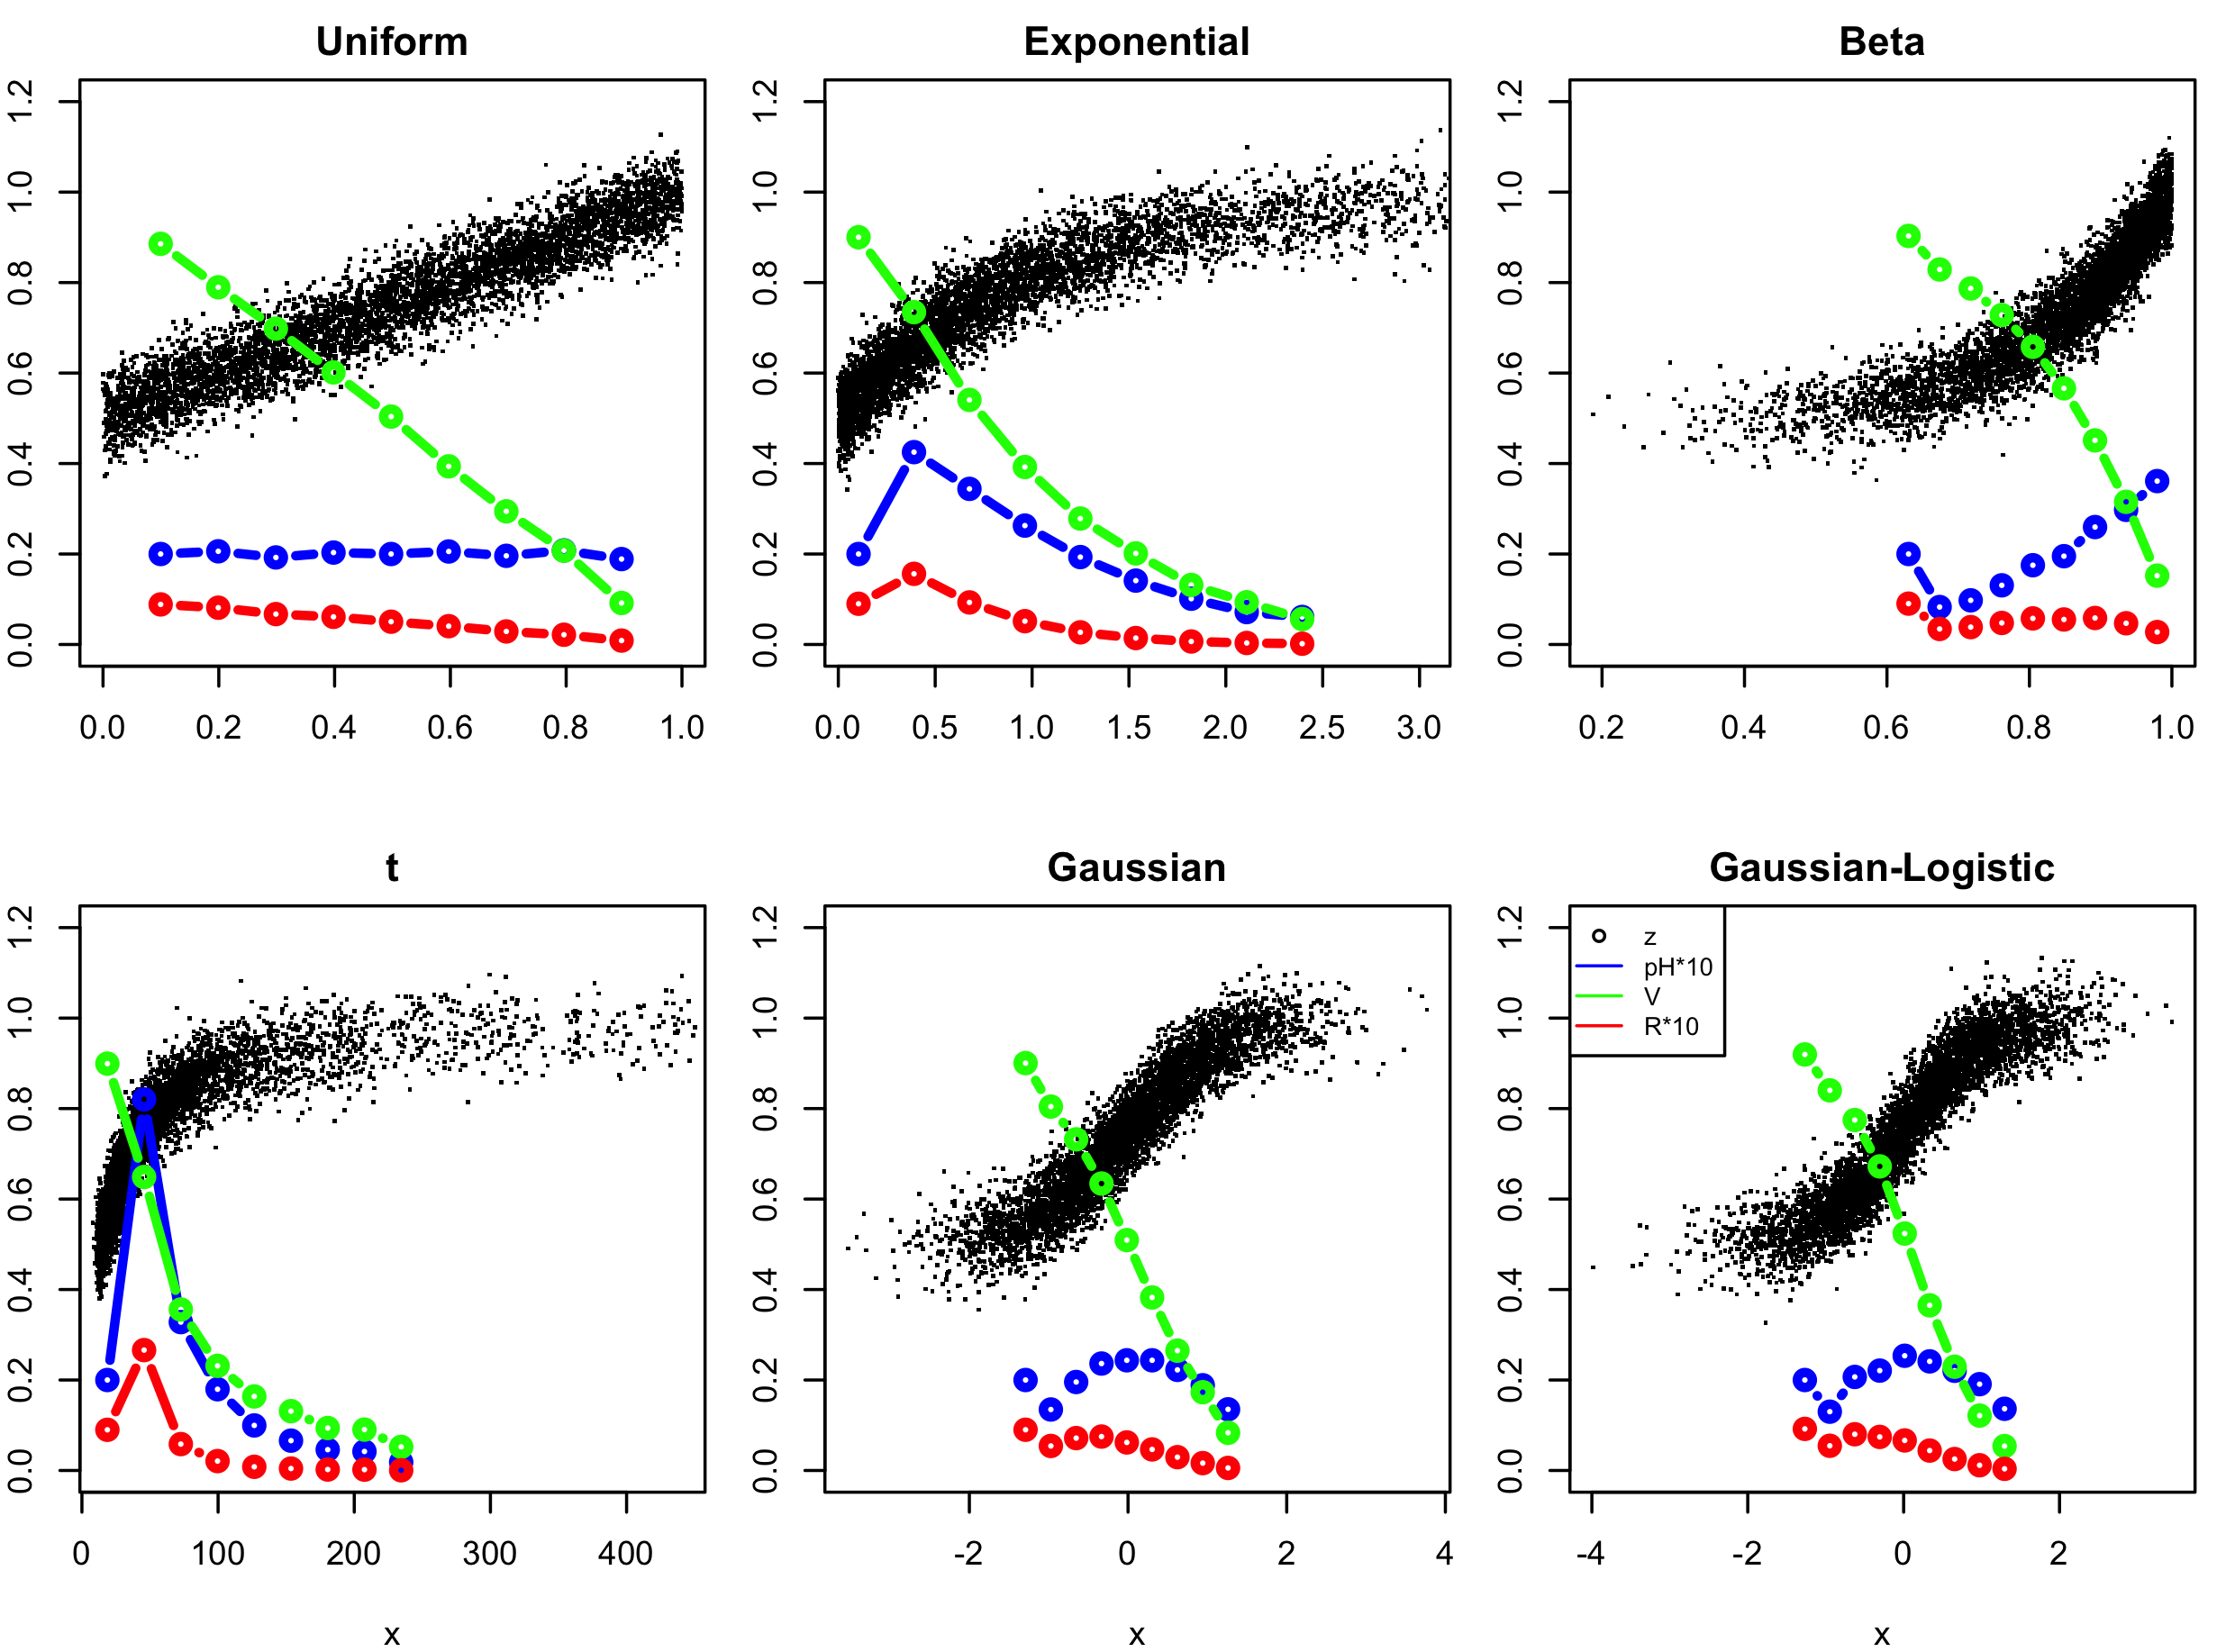
Multi-threshold PRA with equal-x-width intervals

